Slide 1



Amazing Travel Experiences Await!
Discover unforgettable adventures with TripBoss, Hotel Beach Side, and Photosnap websites. From luxurious hotels to stunning photography, these sites offer unique and engaging experiences.
by Divyansh Jain

Slide 2



TripBoss: Experience the Beauty of Our World
Majestic Landscapes
Rich Cultural Experiences
Luxury Cruises
Embark on awe-inspiring journeys, surrounded by majestic mountains and breathtaking landscapes.
Explore the world from a different perspective on our luxurious cruises, offering unparalleled comfort and adventure.
Immerse yourself in vibrant cultures with curated experiences that celebrate local traditions.

Slide 3

TripBoss: Your Gateway to International Adventures

Slide 4
Discover the Beauty of the World
Breathtaking Landscapes
Enchanting Cultures
Adventurous Activities
Imposing mountains
Rich traditions
Thrilling hikes
Glistening lakes
Fascinating history
Exciting water sports
Lush jungles
Vibrant festivals
Wildlife encounters

Slide 5


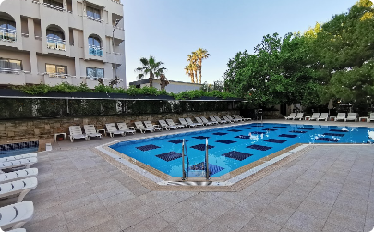
Hotel Beach Side: Luxurious and Welcoming
Welcoming Homepage
Hotel History
Guest Testimonials
Step into a world of luxury and elegance as you enter Hotel Beach Side's meticulously designed website.
Discover the rich heritage and captivating stories behind Hotel Beach Side, a place where luxury meets history.
Hear about the extraordinary experiences of our guests and let their stories entice you to stay with us.

Slide 6

World Class Amenities Await!
Infinity Pool
Dive into the crystal-clear waters of our infinity pool, offering breathtaking views extending to the horizon.
Fine Dining
Indulge in a gastronomic journey with our world-renowned chefs crafting exquisite dishes to satisfy your culinary desires.
Spa Retreat
Relax and rejuvenate in our luxurious spa, where expert therapists ensure a blissful and revitalizing experience.

Slide 7
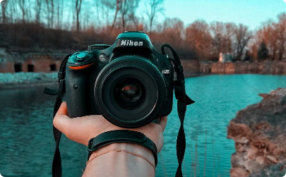


The Art of Storytelling Through Images
Photo Editing
Photo Organization
Photo Sharing
Unlock the full potential of your images with powerful yet user-friendly editing tools.
Effortlessly manage and categorize your ever-growing collection of photographs with intuitive organization features.
Share your stunning captures with the world through seamless sharing options to enhance your online presence.

Slide 8

Unleash Your Creativity with Photosnap
1
Endless Possibilities
Unleash your creativity with powerful editing tools and crafting your visual stories like never before.
2
Engage Your Audience
Capture your audience's attention with stunning visuals and captivating narratives.
3
Seamless Sharing
Share your masterpieces with the world effortlessly through our user-friendly and intuitive platform.

Slide 9
4
Catering to Photographers and Storytellers
Photosnap is a platform designed for photographers and storytellers, providing them with the necessary tools to express their creativity.
5
Beautiful Stories
Immerse yourself in the enchanting narratives captured by talented photographers from around the world.
6
Versatile Features
Explore a range of features that make editing, organizing, and sharing your photos an effortless and enjoyable experience.
7
Engaging Gallery
Browse a captivating gallery that showcases stunning photographs, inspiring you to embark on your own photographic journey.

Slide 10

Recap: Distinct Offerings of Each Website
1
TripBoss
Luxurious Travel, competitive pricing, expert guides, testimonials, and captivating gallery.
2
Hotel Beach Side
Luxurious homepage design, hotel history, guest testimonials showcasing positive experiences.
3
Photosnap
Array of beautiful stories, versatile features for photographers and storytellers, engaging and visually appealing gallery.
Each website caters to their audience's unique needs, providing unforgettable experiences and inspiring journeys.

